Slide 1
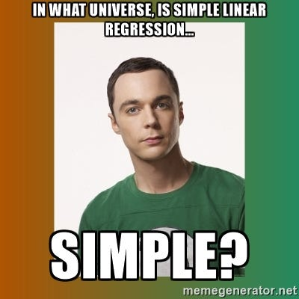
Modeling Using Linear Regressions

Slide 2
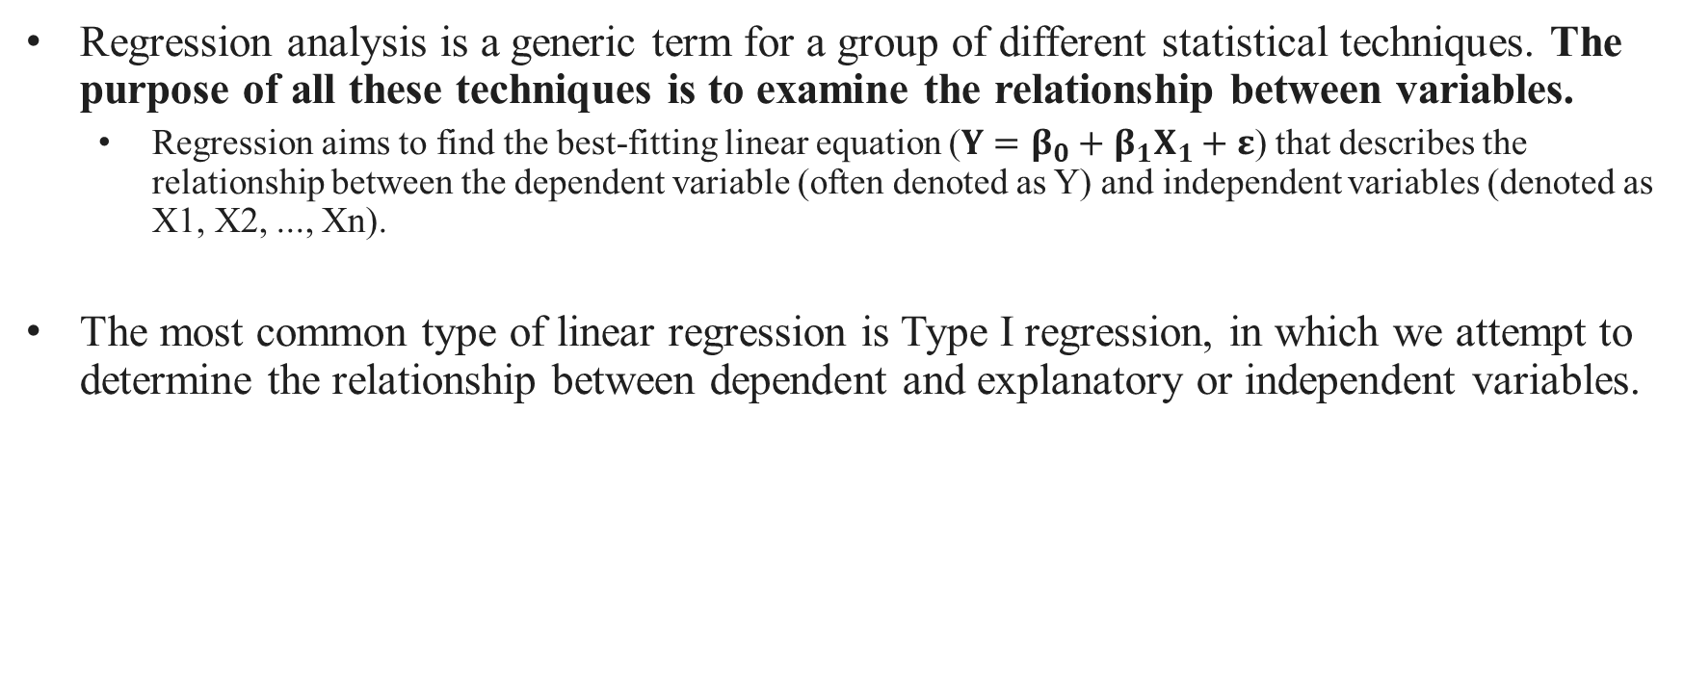
What is regression?
Regression analysis is a generic term for a group of different statistical techniques. The purpose of all these techniques is to examine the relationship between variables.
Regression aims to find the best-fitting linear equation ($Y=β_{0}+β_{1}X_{1}+ε$) that describes the relationship between the dependent variable (often denoted as Y) and independent variables (denoted as X1, X2, ..., Xn).
The most common type of linear regression is Type I regression, in which we attempt to determine the relationship between dependent and explanatory or independent variables.

Slide 3
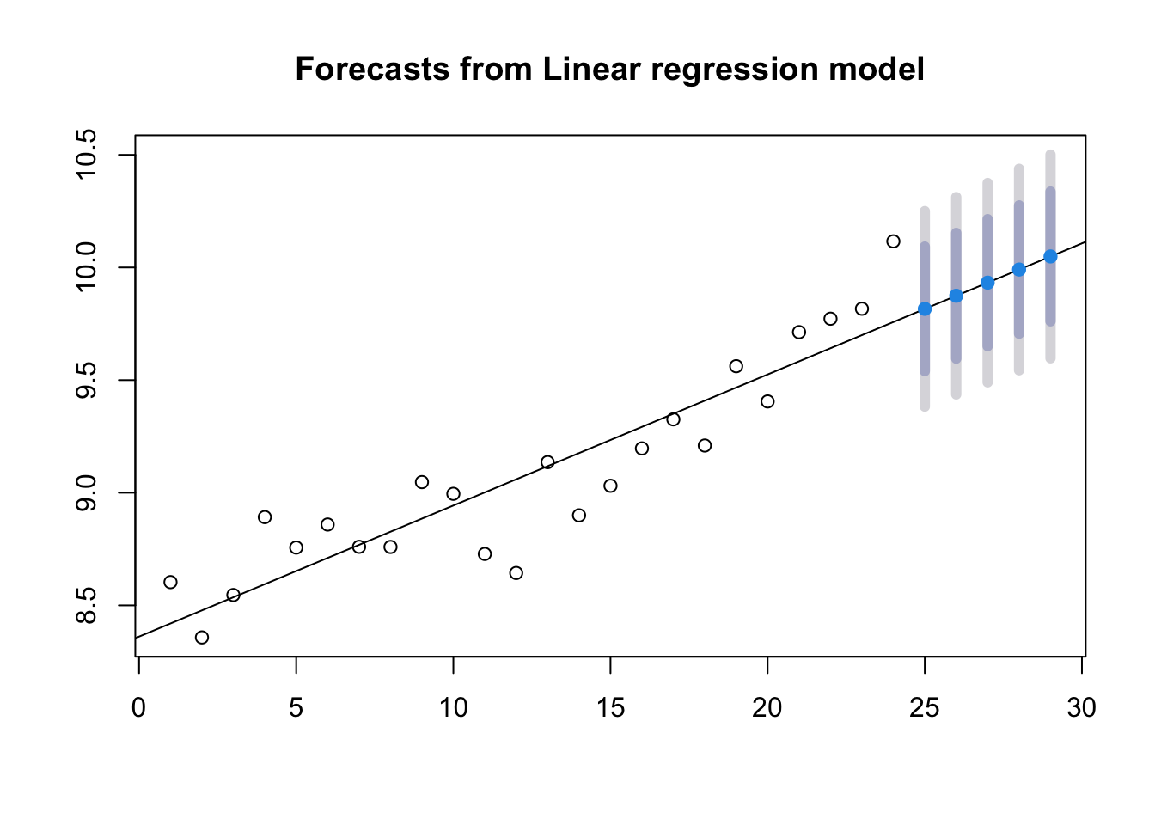
What can we accomplish with linear regression?
Describing the nature of the relationship between two variables.
Predicting the dependent variable within the range of observed values.
Aim to forecast y-values within the range of observed x-values.
Offers relatively more certainty due to reliance on known data.
Predicting the dependent variable beyond the range of observed values.
Represents an exploration beyond the limits of observed data.
Naturally, this type of objective carries the greatest load of restrictions, assumptions, caveats, and risk of error.
y_{i}
x_{i}

Slide 4
Can we use this model to make predictions?
Predicting the dependent variable beyond the range of observed values.
Whether we can use our model to make predictions will depend on:
Whether we can reject the null hypothesis that there is no relationship between our variables.
Whether the model is a good fit for our data.
y_{i}
x_{i}
Notes:
https://www.dataquest.io/blog/statistical-learning-for-predictive-modeling-r/

Slide 5
When would you use a linear regression?
Type of Response Data
Continuous Counts (Frequency) Categorical
Research Question
Difference Relationships Predictions
# of treatment variables
One
# of Input variables
One >1
# Samples (Groups) to Compare
One Two >Two
Simple Linear Regression
Are Samples Independent?
Yes No
# of treatment variables
Two >2
Parametric
Non-Parametric
One sample z-test
Independent t-test
Depend t-test (match pairs)
Analysis of Variance
Pearson’s Correlation
Partial Correlation
Wilcoxon signed rank
z-test
Wilcoxon signed rank Ind. t-test
Wilcoxon signed rank Dep t-test
Kruskal-Wallis ANOVA
Spearman’s Rho

Slide 6
Difference Between Correlation and Linear Simple Regression
Degree & Nature of Relationship:
Correlation is a measure of degree of relationship between X & Y.
Regression studies the nature of relationship between the variables so that one may be able to predict the value of one variable on the basis of another.
Cause & Effect Relationship:
Correlation does not always assume cause and effect relationship between two variables.
Regression clearly expresses the cause and effect relationship between two variables. The independent variable is the cause and dependent variable is effect.
Independent and Dependent Relationship:
In correlation analysis, there is no importance of independent and dependent variables.
In case of regression, there are two coefficients: one indicating the change in the dependent variable per unit change in the independent variable, and the other representing the value of the dependent variable when the independent variable is zero.

Slide 7
When to use a Simple Linear Regression
When to use a simple linear regression:
You have two continuous variables measured on the same unit of observation.
You suspect that they are related (vary in unison).
You want to use measurements of one to make a prediction of the other.
You want to evaluate a trend (slope) over a set of measurements.
Assumptions:
Independent random samples
Linear relationship
Normally distributed residuals (after you obtained the model).

Slide 8
Building blocks of a linear regression model
The goal is to:
Come up with an equation for a line to most accurately predict the response, and …
Evaluate the model: quantify how well the line fits and evaluate how it can (and can’t) be used.
Predicted
value of y
Dependent variable Y
Residuals
Observed value of y
Independent variable X
Notes:
First, we need to understand the goal of a linear regression…
Let's focus on the equation…
https://www.dataquest.io/blog/statistical-learning-for-predictive-modeling-r/

Slide 9
Building blocks of a linear regression model
Calculate the model parameters (intercept and slope) for the line that cuts through the observations with the least amount of error (squared error).
This is referred to as a Least Squares Regression (LSR).
LSR does this by minimizing the sum of the squares of the differences between the observed dependent variable values and those predicted by the linear model.
These differences are called "residuals."
Predicted
value of y
Dependent variable Y
Residuals
Observed value of y
Independent variable X
Notes:
https://www.dataquest.io/blog/statistical-learning-for-predictive-modeling-r/

Slide 10
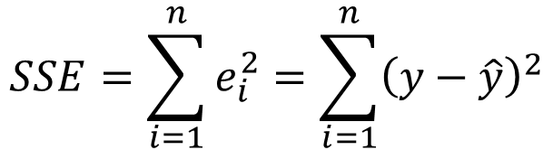

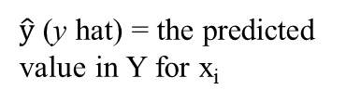
Building blocks of a linear regression model
The sum of squared error in regression is:
Y
$$SSE=\sum_{i=1}^{n}{e_{i}^{2}}=\sum_{i=1}^{n}{{\left(y−\hat{y}\right)}^{2}}$$
.
y_{i}
{
$${\hat{y}}_{i}$$
$\hat{y}$ (y hat) = the predicted value in Y for x_{i}
X
x_{i}
Notes:
https://www.dataquest.io/blog/statistical-learning-for-predictive-modeling-r/

Slide 11
Building blocks of a linear regression model
“Best fit” in context of OLS (Ordinary Least Square, a type of Least Square) means that the sum of the squares of the residuals (or error SSE) us as small as possible.
Mathematically, it’s about finding the values of slope (β₁, β_{2, …,} β_{n}) that minimize this sum.
Predicted
value of y
Dependent variable Y
Residuals
Observed value of y
Independent variable X
Notes:
https://www.dataquest.io/blog/statistical-learning-for-predictive-modeling-r/

Slide 12
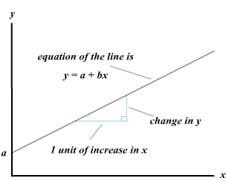
Building blocks of a linear regression model
Slopes (β1, β2, ..., βn): These coefficients represent the change in the dependent variable for a one-unit change in the corresponding independent variable, holding other variables constant.
Predicted
value of y
Slope (β₁)
Dependent variable Y
Independent variable X
Notes:
https://www.dataquest.io/blog/statistical-learning-for-predictive-modeling-r/

Slide 13
Building blocks of a linear regression model
Slopes (β1, β2, ..., βn): These coefficients represent the change in the dependent variable for a one-unit change in the corresponding independent variable, holding other variables constant.
The slope (β1) of your line:
It tells you how much will Y increase with each unit increase in X.
This is what you are interested in when examining trends over time (X).
Predicted
value of y
Slope (β₁)
Dependent variable Y
Independent variable X
Notes:
https://www.dataquest.io/blog/statistical-learning-for-predictive-modeling-r/

Slide 14

Building blocks of a linear regression model
$$Y=β_{0}+β_{1}X_{1}+ε$$
Predicted response
variable
Is the error term that encompasses variability we cannot capture in the model (what X cannot tell us about Y)
Slope (β₁)
Is the model coefficient that represents the model intercept, or where it crosses the y axis
You don’t report the error as a part of your model equation….it is reflected in your accuracy metrics
Dependent variable Y
Is the model coefficient that represents the model slope, the number that gives information about the steepness of the line and its direction (positive or negative)
Residuals
Intercept (β₀)
Observed value of y
Measured Value
Independent variable X
Notes:
https://www.dataquest.io/blog/statistical-learning-for-predictive-modeling-r/

Slide 15
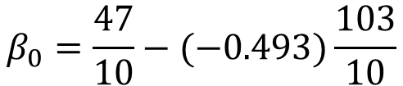
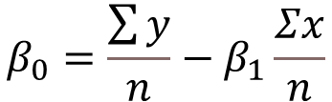

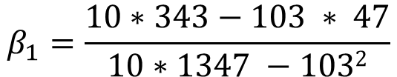

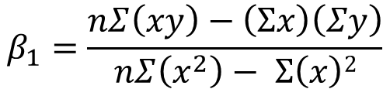


Building blocks of a linear regression model
Inde. var. X | Dep. Var. Y
10 | 5 | 50
15 | 2 | 30
16 | 1 | 16
1 | 9 | 9
4 | 7 | 28
6 | 8 | 48
18 | 1 | 18
12 | 5 | 60
14 | 3 | 42
7 | 6 | 42
103 | 47 | 343
Predicted
value of y
$$Σx=103$$
$$Σy=47$$
$$Σxy=343$$
$$Σx2=1347$$
$$β_{1}=\frac{nΣ\left(xy\right)−\left(Σx\right)\left(Σy\right)}{nΣ\left(x^{2}\right)− Σ\left(x\right)2}$$
$$β_{1}=\frac{10∗343−103 ∗ 47}{10∗1347 −1032}$$
= -0.493
Dependent variable Y
Residuals
$$β_{0}=\frac{\sum{y}}{n}−β_{1}\frac{Σx}{n}$$
$$β_{0}=\frac{47}{10}−(−0.493)\frac{103}{10}$$
= 9.780
Observed value of y
Independent variable X
Notes:
https://www.math.utah.edu/~anna/Sum12/LessonPlans/Section92.pdf

Slide 16


Building blocks of a linear regression model
$$Y=β_{0}+β_{1}X_{1}+ε$$
$$Y=9.780+\left(−0.493 X_{1}\right)+ε$$
$$Σx=103$$
$$Σy=47$$
$$Σxy=343$$
$$Σx2=1347$$
-0.493
$$β_{1}=\frac{nΣ\left(xy\right)−\left(Σx\right)\left(Σy\right)}{nΣ\left(x^{2}\right)− Σ\left(x\right)2}$$
$$β_{1}=\frac{10∗343−103 ∗ 47}{10∗1347 −1032}$$
= -0.493
Dependent variable Y
Residuals
$$β_{0}=\frac{\sum{y}}{n}−β_{1}\frac{Σx}{n}$$
$$β_{0}=\frac{47}{10}−(−0.493)\frac{103}{10}$$
= 9.780
9.780
Observed value of y
Independent variable X
Notes:
https://www.math.utah.edu/~anna/Sum12/LessonPlans/Section92.pdf

Slide 17
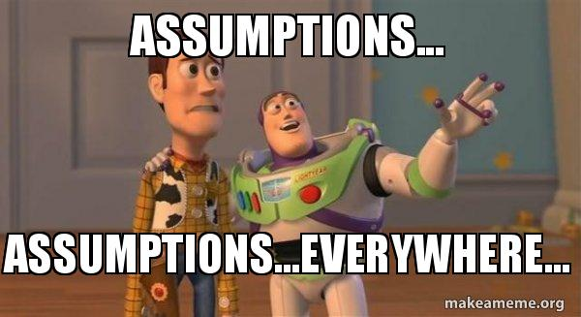
Building blocks of a linear regression model
Testing your assumptions.
Notes:
https://www.math.utah.edu/~anna/Sum12/LessonPlans/Section92.pdf

Slide 18
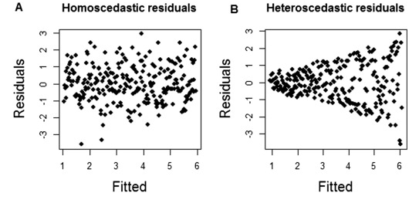

Testing your Assumptions
Assumptions:
Independent random samples
Linear relationship
Normally distributed residuals.
Are the residuals relatively constant (homoscedastic)?
A. Constant distribution (spread) of residuals.
B. Heteroscedasticity apparent: the spread of residuals increases as the fitted values increase.
Notes:
https://www.sciencedirect.com/science/article/pii/S002209811530023X?casa_token=sQ_XD5gReaAAAAAA:l04R5ymjuoU3JkDOibxeu7G3fen2jNSzOJ50TMPH176lZXrXIr4VjbkvjIo8Vq_aYtKczCmgyvyV

Slide 19
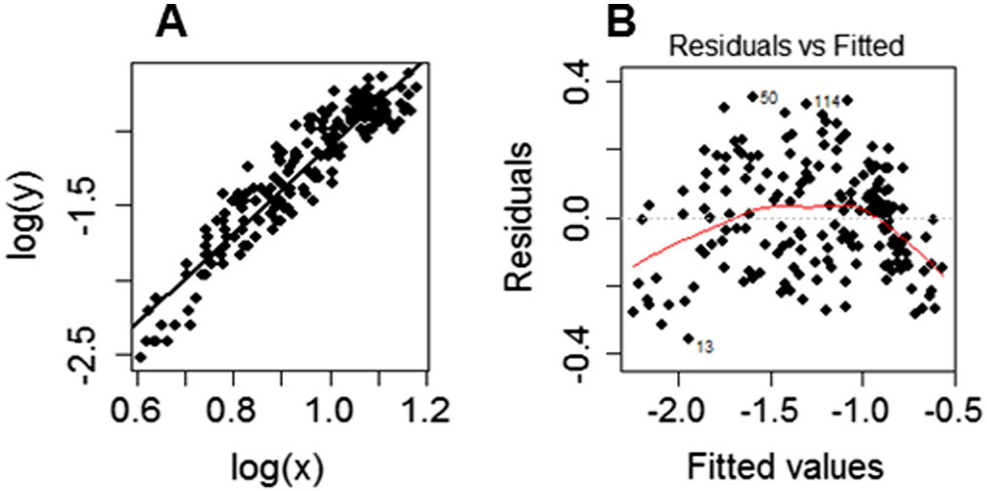
Testing your Assumptions
Assumptions:
Independent random samples
Linear relationship
Normally distributed residuals.
Are the residuals relatively constant (homoscedastic)?
Are your residuals normally distributed?
A. Constant distribution (spread) of residuals.
B. Diagnostic plot of residuals vs fitted values. If the data fit a linear model, the residuals should be grouped near the zero horizontal line. The curved line is a calculated LOESS curve which shows the directions of the distortions from linearity.
Note that the horizontal axis in such a plot consists of the predicted (or ‘fitted’) values (Y).
LOESS curve (Locally weighted scatterplot smoothing: a non-parametric technique that graphically represents a curve of best fit without assumptions of data distribution. LOESS is not necessary but can facilitate the detection of linearity violation.
Notes:
https://www.sciencedirect.com/science/article/pii/S002209811530023X?casa_token=sQ_XD5gReaAAAAAA:l04R5ymjuoU3JkDOibxeu7G3fen2jNSzOJ50TMPH176lZXrXIr4VjbkvjIo8Vq_aYtKczCmgyvyV

Slide 20
Building blocks of a linear regression model
The goal is to:
Come up with an equation for a line to most accurately predict the response, and …
Evaluate the model: quantify how well the line fits and evaluate how it can (and can’t) be used.
Predicted
value of y
Dependent variable Y
Residuals
Observed value of y
Independent variable X
Notes:
First, we need to understand the goal of a linear regression…
Let's focus on the equation…
https://www.dataquest.io/blog/statistical-learning-for-predictive-modeling-r/

Slide 21
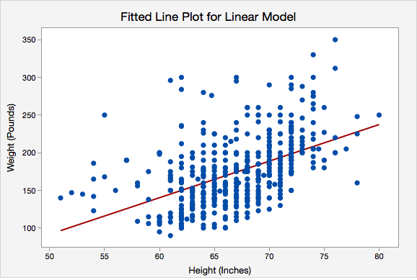
Model Evaluation – Working Range
Other considerations you must include in your evaluation of any regression model:
What is the range of values across which my model is valid?
Your model will only work across the range of X and Y values that are represented in your data. The model should not be used to predict Y for any X observations that fall outside of that working range.
Typically, your min and max data values, but examine your data for large gaps

Slide 22
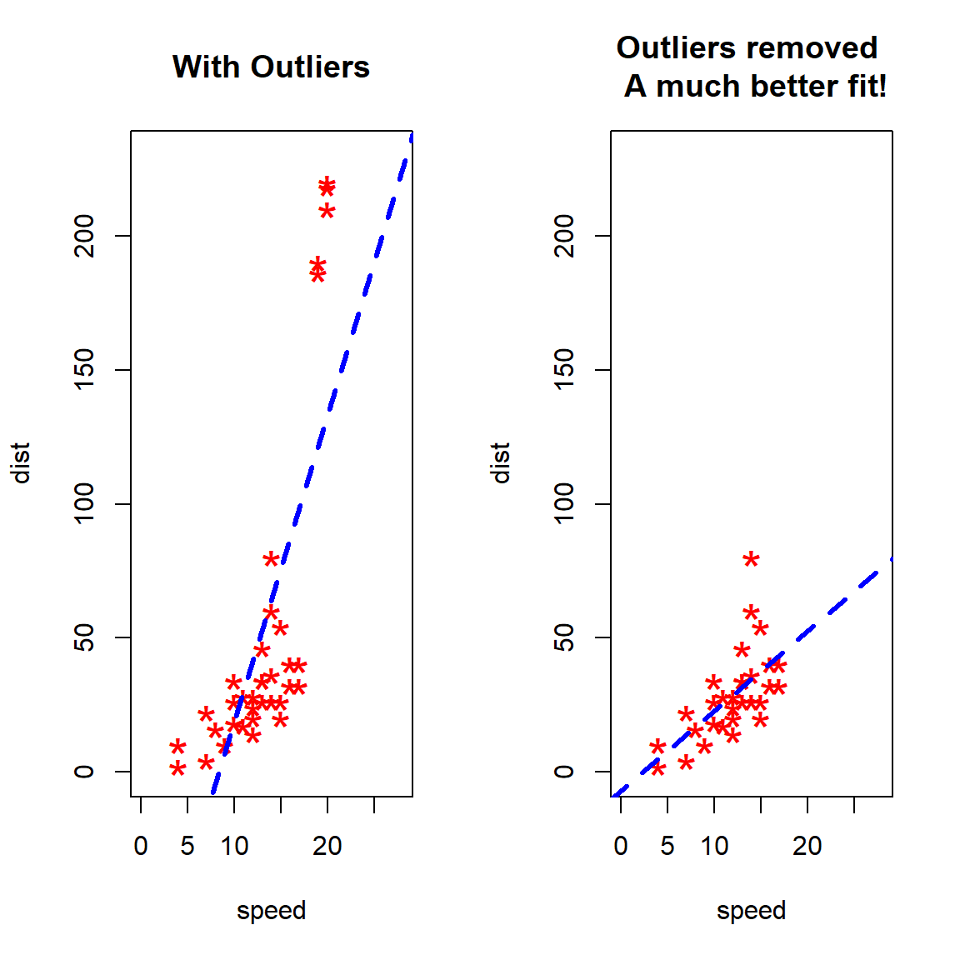
Model Evaluation – Outliers
Other considerations you must include in your evaluation of any regression model:
Are there outliers that may be influencing my diagnostic metrics?
An outlier (also called leverage points ) is a point that falls far from the other data points.
These will have high residual values (error).
Notes:
https://ouzhang.me/blog/outlier-series/outliers-part3/
https://ouzhang.me/blog/outlier-series/outliers-part3/#regression-outliers

Slide 23
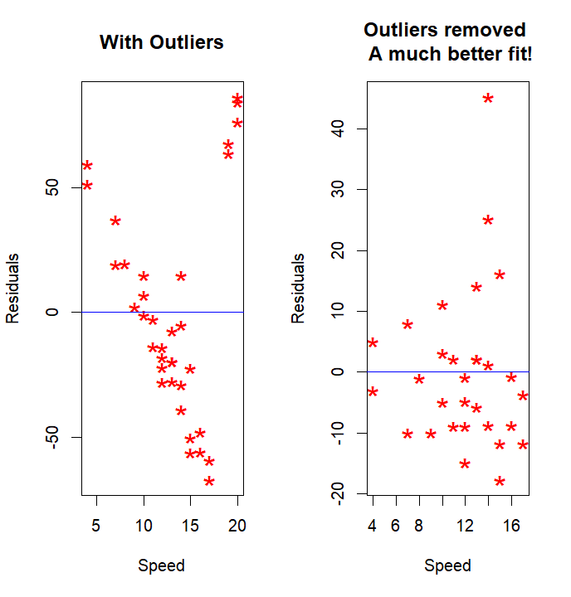
Model Evaluation – Outliers
Other considerations you must include in your evaluation of any regression model:
Are there outliers that may be influencing my diagnostic metrics?
Remember: We can only remove data that is bad OR that we have no confidence in (for example it is well outside of the “working” range of other observations) OR that has such high leverage that it overly influences the regression model.
Notes:
https://ouzhang.me/blog/outlier-series/outliers-part3/

Slide 24
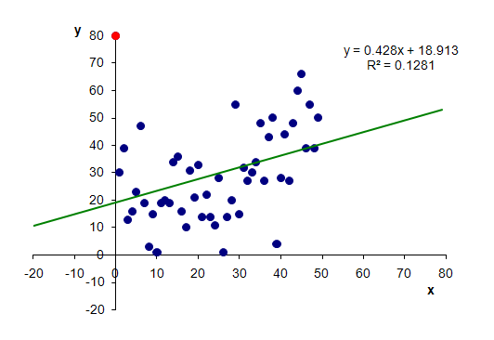
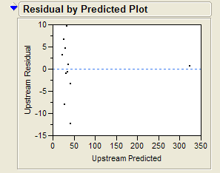
Model Evaluation – Outliers - High leverage points
High leverage points cause model parameters (β₀, β₁, ԑ) change a great deal when the point is removed from the calculations.
They can change model fit, significance and your overall conclusions about your regression.
We can test for high leverage points using Cook’s D.

Slide 25
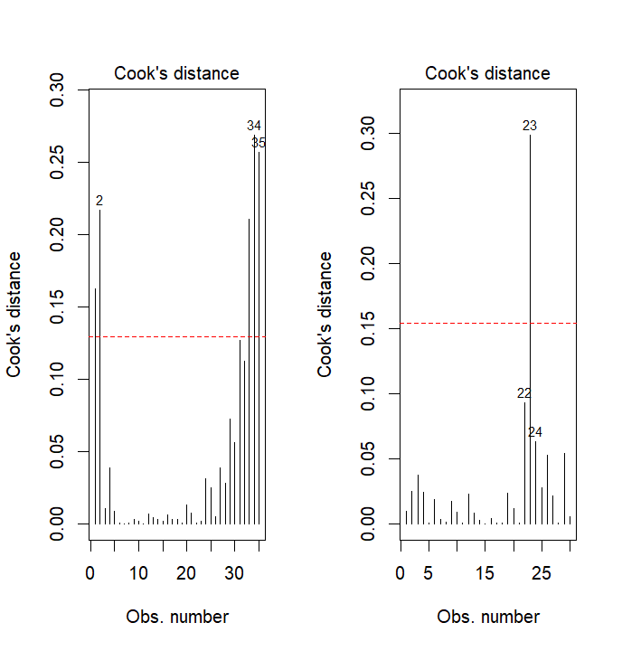
Model Evaluation – Outliers - High leverage points
Cook's distance (D) measures the effect of deleting a given observation. A measure of an observations influence on the regression equation.
Look for observations with high Cook’s D values relative to the rest of the samples.
This does not mean it is a BAD observation or even a true outlier
It does mean that it is an extreme value that is weighted very heavily in calculating the regression model coefficients. You need to look at this observation closely to see if it truly belongs (based on your modeling goals)

Slide 26
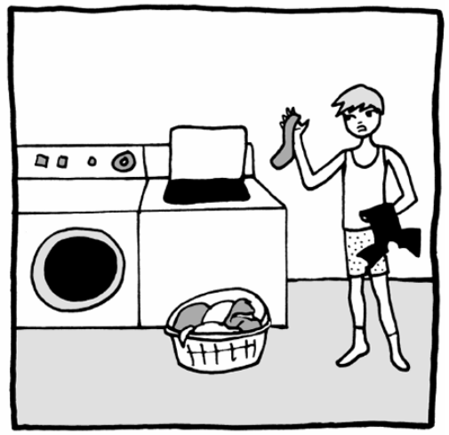
Model Evaluation – Outliers - To remove or not to remove
When deciding if we should remove a high leverage point, we should consider the following:
Data Quality.
Is the observation within the working range of our model?
What happens if you take it out?
Data cleansing can be dangerous.
You don’t want to lose important information.

Slide 27
Model Evaluation – Outliers - To remove or not to remove
1. Data Quality
Was the data measured properly?
Does it make biological sense to see an outlier like this?
Are there other reasons why this observation differs so much from the others (i.e. was it a really hot day, did they shock a larger area than usual, had a log jam just been removed downstream, etc?)
Data cleansing can be dangerous.
You don’t want to lose important information.

Slide 28
Model Evaluation – Outliers - To remove or not to remove
2. Is the observation within the working range of our model?
Perhaps expanding the observations in that range would help inform your decision….or at least distinguish between how the relationship really is at that level vs. what is just a messed up measurement.
Regression models are not valid outside of the range of data used to develop predictive equations.
Data cleansing can be dangerous.
You don’t want to lose important information.

Slide 29
Model Evaluation – Outliers - To remove or not to remove
3. What happens if you take it out?
Does the slope change?
Fit increase or decrease substantially?
Essentially…..does the nature of the model change based on one observation …..a robust model won’t change dramatically.
To be useful, models should not change with new data configurations.
Data cleansing can be dangerous.
You don’t want to lose important information.

Slide 30
Model Evaluation
Calculate the equation.
Significance: is the relationship due to a true pattern or just random chance?
Meaningful: how much variability can be explained by this model and is this useful?
How accurate are your predictions?
How stable is your model?

Slide 31

Model Evaluation: Significance
Model significance
To test if one variable is significantly related to another for prediction, we just test the correlation.
This means that when we create a regression equation, we need to calculate and test the correlation coefficient as well

Slide 32
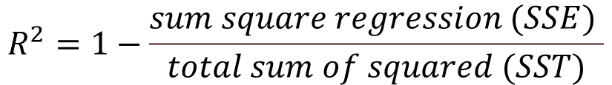
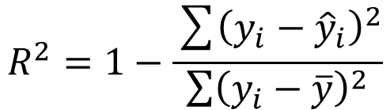
Model Evaluation: Meaningful
Model meaningfulness
R-Squared (R² or the coefficient of determination) is a statistical measure in a regression model that determines the proportion of variance in the dependent variable that can be explained by the independent variable.
It ranges from 0 to 1, with higher values indicating a better fit of the model to the data.
If R² (read it as R-Squared)= 0.43 for the above regression equation, then it means that 43% of the variability in y is explained by the variables x.
$$R^{2}=1−\frac{sum square regression (SSE) }{total sum of squared (SST)}$$
$$R^{2}=1−\frac{\sum{{\left(y_{i}−{\hat{y}}_{i}\right)}^{2}}}{\sum{{\left(y_{i}−\overline{y}\right)}^{2}}}$$
SSE= The sum squared regression is the sum of the residuals squared.
SST= the total sum of squares is the sum of the distance the data is away from the mean all squared.
Notes:
The sum squared regression is the sum of the residuals squared, and the total sum of squares is the sum of the distance the data is away from the mean all squared.

Slide 33


Model Evaluation: Accuracy
Model Accuracy
How much the actual (measured) value differs from the equation predicted value (on average).
The higher the correlation between two variables (and the better the prediction), the lower the error will be.
$$RMSE=\sqrt{\frac{\sum{{\left(y_{i}−{\hat{y}}_{i}\right)}^{2}}}{n−1}}$$
Root Mean Square Error (RMSE)
=
y_{i} = Observer value
$\hat{y}$= Predicted value
Notes:
https://arize.com/blog-course/root-mean-square-error-rmse-what-you-need-to-know/

Slide 34
Model Evaluation: Accuracy
Interpreting RMSE
This calculated value essentially tells you, on average, how far off your predictions are from the actual measured response (average error)
So, for example, a RMSE of 6.67 says are usually predicting to within ~7 units
Smaller is better BUT…really it is in reference to the mean response that you evaluate RMSE
Best to interpret the proportion of error:
Percent Error = RMSE / Mean of the response
Just like with r², you will have to decide if this proportion of error is an acceptable margin of error for the purposes of your model.

Slide 35
Model Evaluation: Stability
A model is said to be stable if the model parameters (β₀, β₁, ԑ) and model evaluation metrics remain relatively constant when new observations are introduced.

Slide 36
Model Evaluation: Stability
Mathematicians looked for a way to simulate independent validation, without having to give up any observations for equation development, their simple solution: Jackknifed residuals

Slide 37

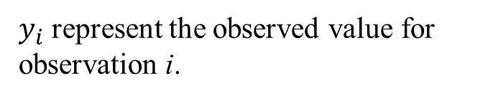
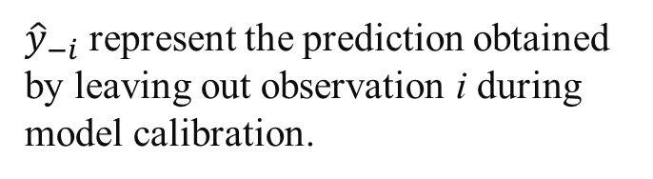
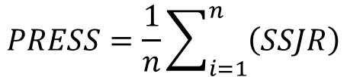

Model Evaluation: Stability
${\hat{y}}_{−i}$ represent the prediction obtained by leaving out observation i during model calibration.
Leave each observation out one at a time and re-calibrate the model equation without that observation.
Predict back on the observation independently.
Calculate how far off your jackknifed observation is from its prediction = Jackknifed residual (JR).
Square all the JRs.
Sum the squared Rs.
Divide by the number of observations to come up with an average jackknifed error (PRESS statistic)
$y_{i}$ represent the observed value for observation i.
$$JR_{i}=y_{i}−{\hat{y}}_{−i}$$
$$SSJR=\sum_{i=1}^{n}{\left(JR_{i}\right)2}$$
$$PRESS=\frac{1}{n}\sum_{i=1}^{n}{\left(SSJR\right)}$$
Notes:
https://online.stat.psu.edu/stat501/lesson/10/10.5

Slide 38
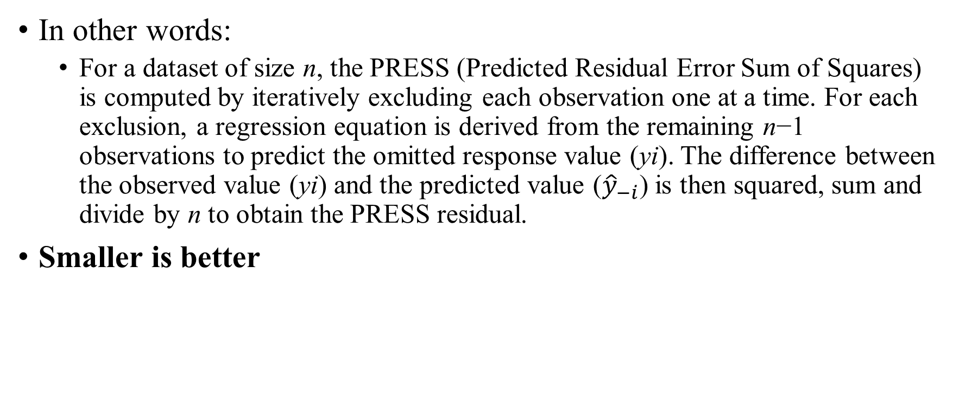
Model Evaluation: Stability
In other words:
For a dataset of size n, the PRESS (Predicted Residual Error Sum of Squares) is computed by iteratively excluding each observation one at a time. For each exclusion, a regression equation is derived from the remaining n−1 observations to predict the omitted response value (yi​). The difference between the observed value (yi​) and the predicted value (​${\hat{y}}_{−i}$) is then squared, sum and divide by n to obtain the PRESS residual.
Smaller is better

Slide 39
Model Evaluation: Stability
If your Press RMSE is more than 1.5 times your RMSE you have an Unstable model, and this will likely not work well on new data as a predictive tool.

Slide 40
Writing it all UP
You paragraph summary of your statistical analysis should include the following:
Hypothesis or research objectives clearly stated
Correct statistical test selected and clearly stated
Simple Linear Least Squares Regression (no assumption for normality of variables, only of residuals (actual vs. predicted)
Include the model equation in Y = b + mX format
To describe the model include:
r2 ... how meaningful is the mode
RMSE ... how accurate is the model
PRESS RMSE ... how stable is the model
p-value .... how significant is the relationship the model is based on
Any outliers? Does removing them impact the equation values, accuracy or significance?
Interpretation……..How useful do you think this model will be for its intended purpose (link back to the original objective). Consider all of the metrics you described above as well as the range over which the model is valid.

Slide 41

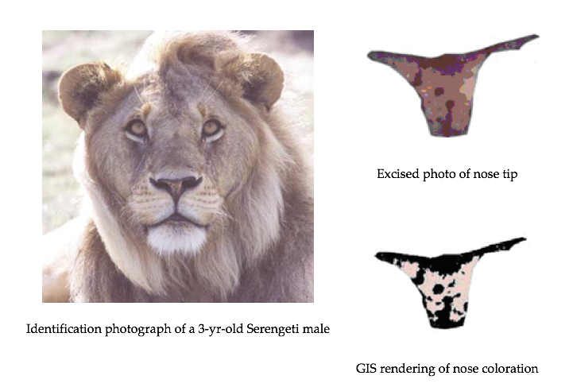
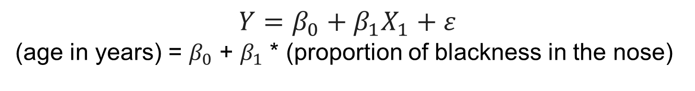
Case Study: Whitman et al. (2004)
The proportion of blackness in a male lion’s nose increases as the lion ages.
This proportion can be used to predict the age of a lion with unknown age.
$$Y=β_{0}+β_{1}X_{1}+ε$$
(age in years) = $β_{0}$ + $β_{1}$ * (proportion of blackness in the nose)
Notes:
https://pages.cs.wisc.edu/~st571-1/15-regression-4.pdf

Slide 42
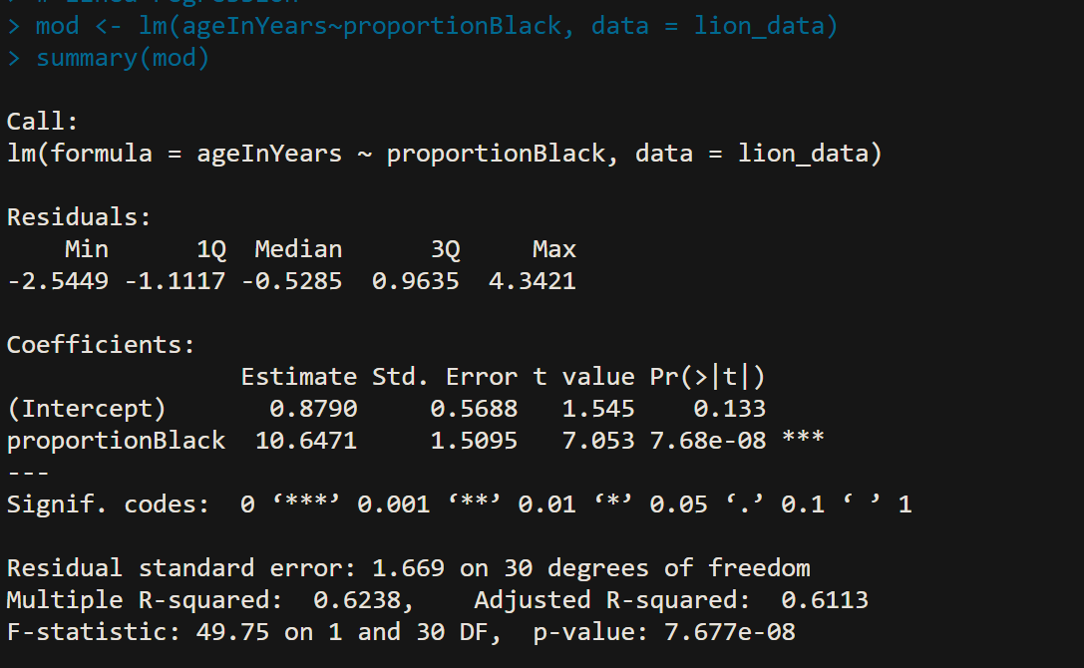
Simple Liner Regression output in R

Slide 43
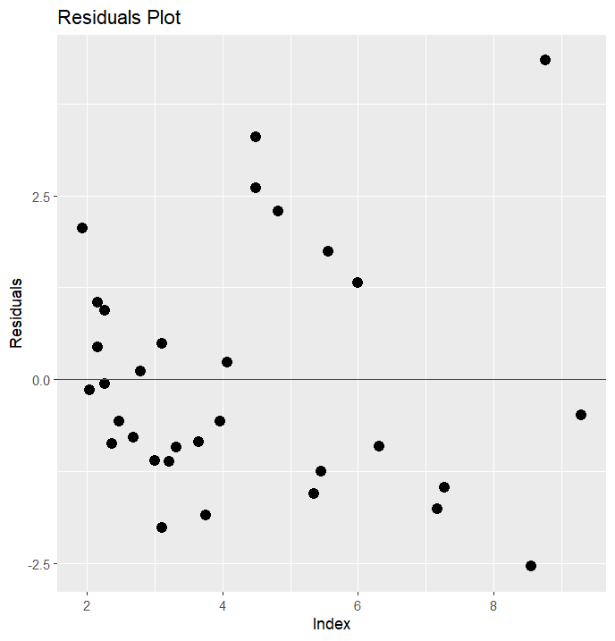
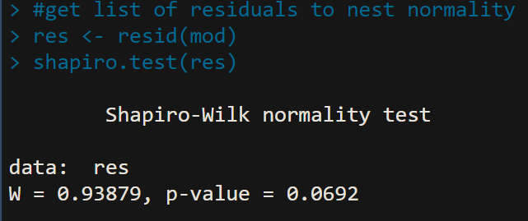

Simple Liner Regression output in R
The presence of substantial nonlinearity is not apparent.
While there may be a slight increase in residual trend with X, it remains within “acceptable bounds”.
There are no notable occurrences of extreme outliers or significant skewness.

Slide 44
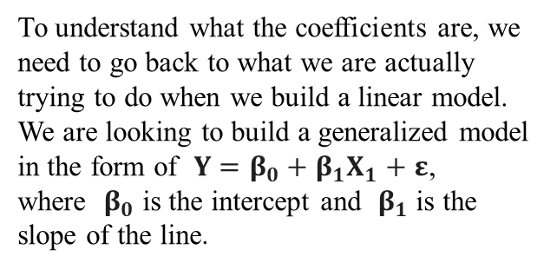
Simple Liner Regression output in R
The call section shows us the formula that R used to fit the regression model.
proportionBlack is our dependent variable and we are using ageInYears as a predictor (independent variable) from the lion_data dataset.
The residuals are the difference between the actual values and the predicted values.
To understand what the coefficients are, we need to go back to what we are actually trying to do when we build a linear model. We are looking to build a generalized model in the form of $Y=β_{0}+β_{1}X_{1}+ε$, where $β_{0}$ is the intercept and $β_{1}$ is the slope of the line.

Slide 45
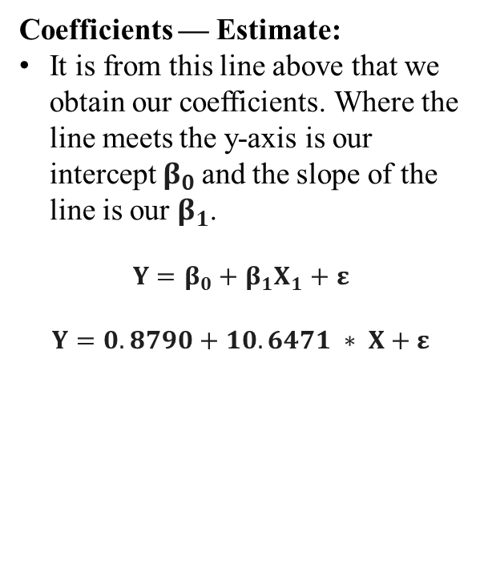
Simple Liner Regression output in R
Coefficients — Estimate:
It is from this line above that we obtain our coefficients. Where the line meets the y-axis is our intercept $β_{0}$and the slope of the line is our $β_{1}$.
$$Y=β_{0}+β_{1}X_{1}+ε$$
$$Y=0.8790+10.6471 ∗ X+ε$$

Slide 46
Simple Liner Regression output in R
Coefficients — Std. Error:
The standard error of the coefficient is an estimate of the standard deviation of the coefficient.
In effect, it is telling us how much uncertainty there is with our coefficient.
The standard error is often used to create confidence intervals.
10.6471 ± 1.96(1.5095) = (7.68958, 13.60462)

Slide 47
Simple Liner Regression output in R
Coefficients — t value:
The t-statistic is simply the coefficient divided by the standard error.
In general, we want our coefficients to have large t-statistics, because it indicates that our standard error is small in comparison to our coefficient.

Slide 48
Simple Liner Regression output in R
Coefficients — Pr(>|t|)
The p-value is calculated using the t-statistic from the T distribution.
The p-value, in association with the t-statistic, help us to understand how significant our coefficient is to the model.
In practice, any p-value below 0.05 is usually deemed as significant.

Slide 49
Simple Liner Regression output in R
Coefficients — Signif. codes:
To the right of the p-values you’ll see several asterisks.
The number of asterisks corresponds with the significance of the coefficient as described in the legend just under the coefficients section.
The more asterisks, the more significant.

Slide 50
Simple Liner Regression output in R
Residual Standard Error:
The residual standard error is a measure of how well the model fits the data.
The residual standard error tells us the average amount that the actual values of Y (the dots) differ from the predictions (the line) in units of Y.

Slide 51
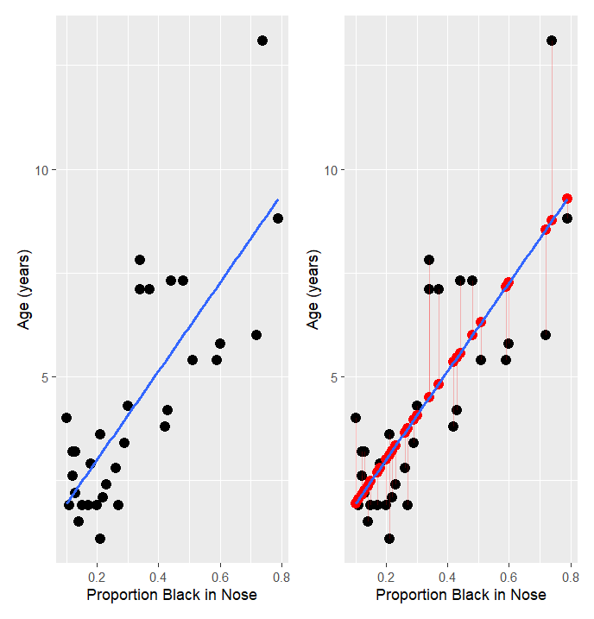
Simple Liner Regression output in R
Residual Standard Error:
The residual standard error is a measure of how well the model fits the data.
The residual standard error tells us the average amount that the actual values of Y (the dots) differ from the predictions (the line) in units of Y.
In general, we want the smallest residual standard error possible, because that means our model’s prediction line is very close to the actual values, on average.

Slide 52
Simple Liner Regression output in R
Multiple R-squared:
It tells us what percentage of the variation within our dependent variable that the independent variable is explaining.
In the example above, lion age explains ~62% of the variation within Proportion of Black Spots, our dependent variable.

Slide 53
Simple Liner Regression output in R
Multiple Adjusted R-squared:
The Adjusted R-squared value is used when running multiple linear regression.
is the same a multiple R-squared but adjusted for the number of variables in the model. So, it reflects the proportion of variance in y that can be explained by the predictors x and z beyond what we get if we added a random variable.

Slide 54
Simple Liner Regression output in R
F-statistic and p-value:
When running a regression model, either simple or multiple, a hypothesis test is being run on the global model.
The null hypothesis is that there is no relationship between the dependent variable and the independent variable(s) and the alternative hypothesis is that there is a relationship.
H₀ is that the coefficients for all of the variables in your model are zero.
H₁ is that at least one of them is not zero.

Slide 55
Simple Liner Regression output in R
F-statistic and p-value:
The F-statistic and overall p-value help us determine the result of this test.
A larger F-statistic generally indicates that the null hypothesis should be rejected.
But, a better approach is to utilize the p-value that is associated with the F-statistic.
A p-value below 0.05 generally indicates that you have at least one coefficient in your model that isn’t zero.
Notes:
The degrees of freedom df are the sample size minus the number of parameters that we are trying to estimate.

Slide 56

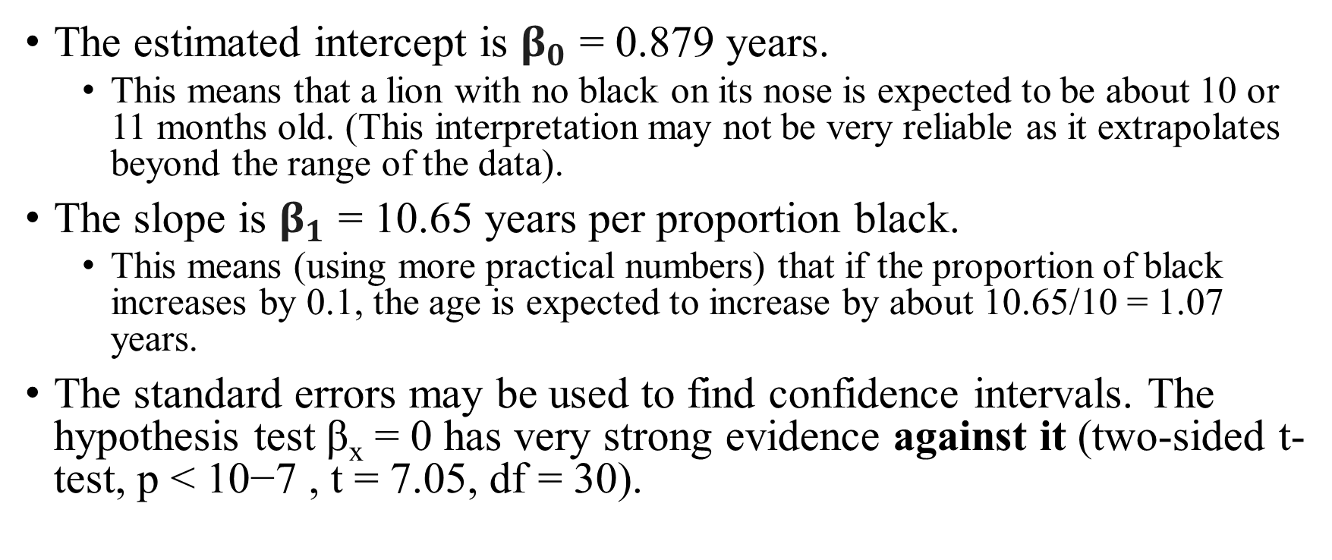
Interpretation
$$Y=β_{0}+β_{1}X_{1}+ε$$
$$Y=0.8790+10.6471 ∗ X+ε$$
The estimated intercept is $β_{0}$ = 0.879 years.
This means that a lion with no black on its nose is expected to be about 10 or 11 months old. (This interpretation may not be very reliable as it extrapolates beyond the range of the data).
The slope is $β_{1}$ = 10.65 years per proportion black.
This means (using more practical numbers) that if the proportion of black increases by 0.1, the age is expected to increase by about 10.65/10 = 1.07 years.
The standard errors may be used to find confidence intervals. The hypothesis test β_{x} = 0 has very strong evidence against it (two-sided t-test, p < 10−7 , t = 7.05, df = 30).

Slide 57
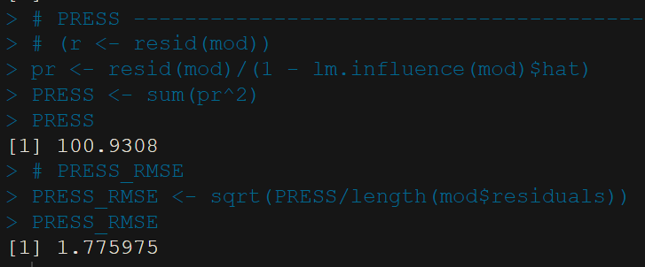
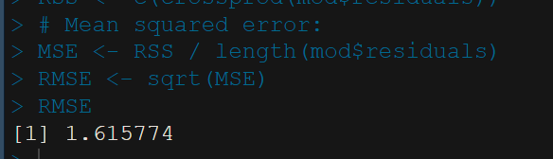
Simple Liner Regression output in R
If your Press RMSE is more than 1.5 times your RMSE you have an Unstable model

